Slide 1

Twitter Streaming and Analysis
Compro MIU Big Data Technologies (CS523)
Group Project
Members:
Demisew Mokonnen
Dereje Kenno
Amare Ayele

Slide 2
outline
Introduction
Tools we used
signing up for twitter developer account
Kafka as stream-processing software platform
saving streamed data as parquet and hive table.
Spark SQL
Data Visualization
references

Slide 3
Introduction
What is Twitter?
Twitter is a 'microblogging' system that allows you to send and receive short posts called tweets. Tweets can be up to 140 characters long and can include links to relevant websites and resources.
Twitter users follow other users
why use Twitter?
To tweet your celebrations, grievances, and follow what is happening elsewhere
following, being followed, tweet, retweet, # tags create social interaction.
therefore, it is interesting to analyze it.
Our Goal
to Create end to end pipeline that will consume tweets from twitter api save it temporarily or permanently on hdfs and to visualize it using visualization tools.
To demonstrate by firing some queries and plotting some graphs using Jupyter.

Slide 4
Tools we used
Twitter API (source)
kafka (stream-processing)
scala-ide (scala lang)
spark streaming
spark SQL
HIVE
Parquet
Jupyter

Slide 5
signing up for twitter developer account
create Twitter Developer Account
Step 1: got to https://developer.twitter.com/ )
Step 2: Click “Apply”
Step 3: Click “Apply for a developer account”
Step 4: Login with your Twitter Account
Step 5: Fill the “form”
for educational purposes twitter apporoves it in no time.
Then
create Twitter App
Step 1: Login Twitter Developer App
Step 2: Click “Your name” on right side top
Step 3: Click “Get Started”
Step 4 : Click “Create an app”
step 5: Write App name and other details.
Step 6: Click “Create”

Slide 6
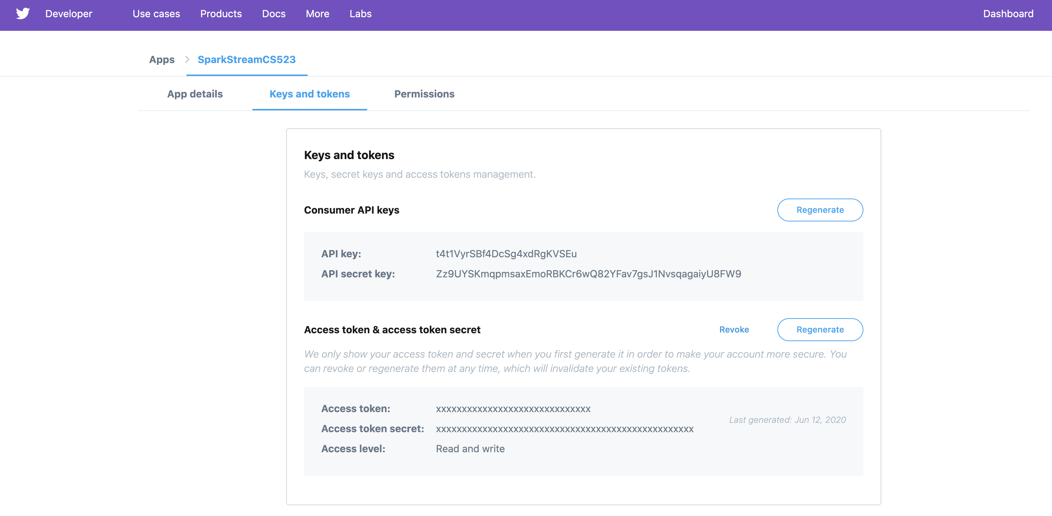

Slide 7
Kafka as stream-processing software platform
Apache Kafka is a streaming message platform. It is designed to be high performance, highly available, and redundant. Examples of applications that can use such a platform include:
Internet of Things. TVs, refrigerators, washing machines, dryers, thermostats, and personal health monitors can all send telemetry data back to a server through the Internet.
Social media: facebook, twitter, liker (new), ….
Sensor Networks. Areas (farms, amusement parks, forests) and complex devices (engines) can be designed with an array of sensors to track data or current status.
Positional Data. Delivery trucks or massively multiplayer online games can send location data to a central platform.
Other Real-Time Data. Satellites and medical sensors can send information to a central area for processing.

Slide 8
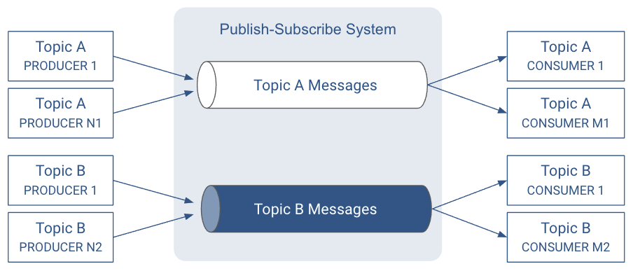
Kafka as stream-processing software platform
Topics
A topic allows easy matching between publishers and subscribers.

Slide 9
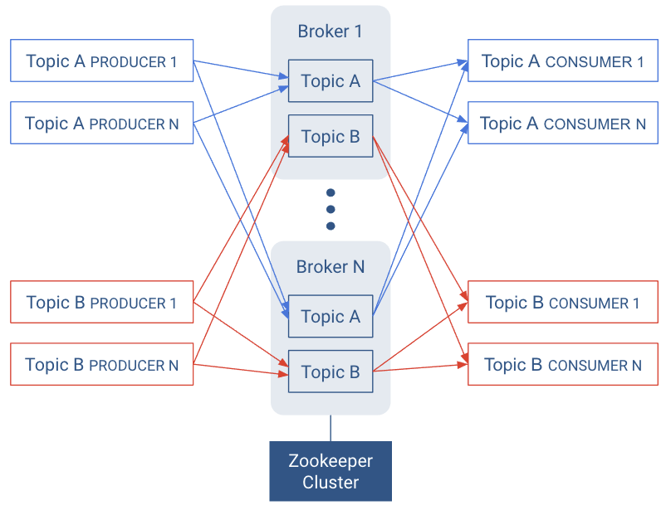
Kafka as stream-processing software platform
Brokers
Each host in the Kafka cluster runs a server called a broker that stores messages sent to the topics and serves consumer requests.
Kafka brokers all talk to Zookeeper for distributed coordination

Slide 10
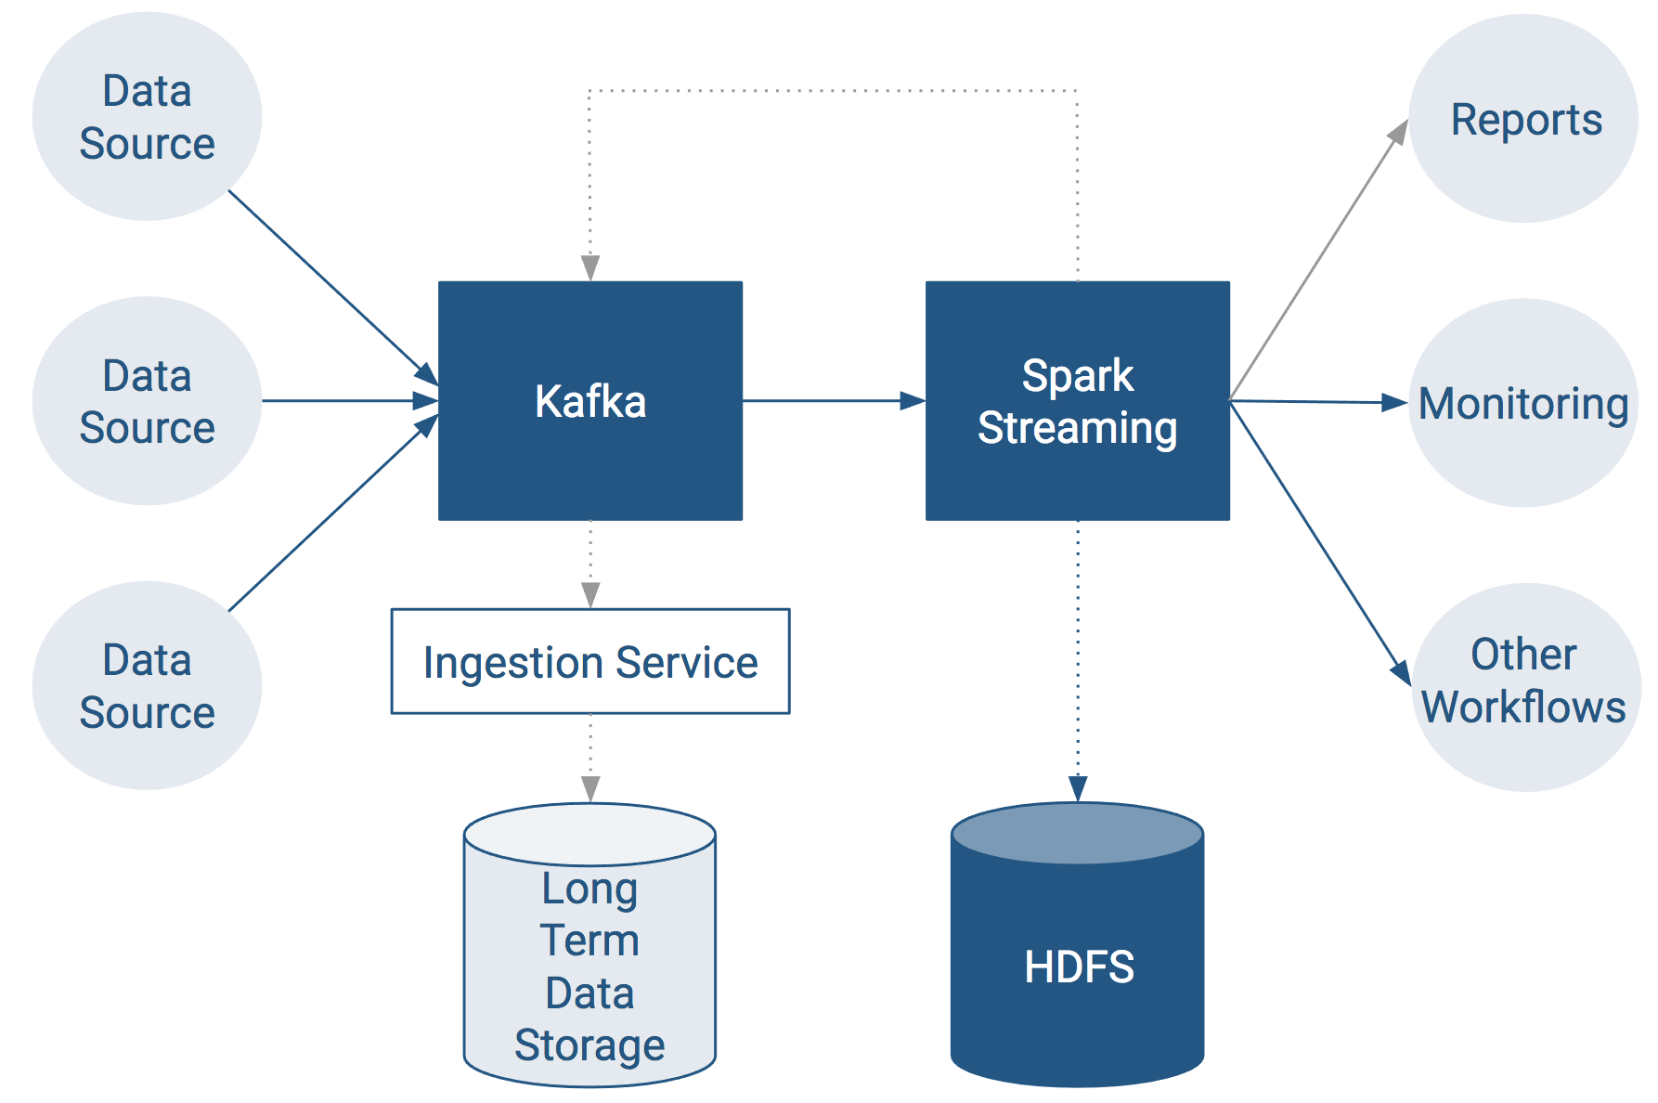
Kafka as stream-processing software platform
For real-time stream computation, Apache Spark is the tool of choice.
End-to-End Data Streaming Pipeline

Slide 11

End-to-End Data Streaming Pipeline

Slide 12
Kafka as stream-processing software platform (Commands to install kafka and client interactions on centos 6.7)
Then follow the following steps to install Apache Kafka on linux
Step 1 $cd /etc/yum.repos.d
Step 2 $wget http://archive.cloudera.com/kafka/redhat/6/x86_64/kafka/
Step 3 $sudo yum clean all
Step 4 $sudo yum install kafka
Step 5 $sudo yum install kafka-server
Step 6 $sudo service kafka-server start
we assumed Cloudera QuickStart zookeeper is already running
Step 7 Create topic (eg cs523)
$cd /usr/lib/kafka/bin
$./kafka-topics.sh --create --zookeeper localhost:2181 --replication-factor 1 --partitions 1 --topic cs523
Step 8 List topics
$./kafka-topics.sh --list --zookeeper localhost:2181
Step 9 start producer
$./kafka-console-producer.sh --broker-list localhost:9092 --topic cs523
Step 10 start consumer on another terminal tab. Remember changing working director to cd /usr/lib/kafka/bin/
$./kafka-console-consumer.sh --zookeeper localhost:2181 --topic cs523 --from-beginning

Slide 13
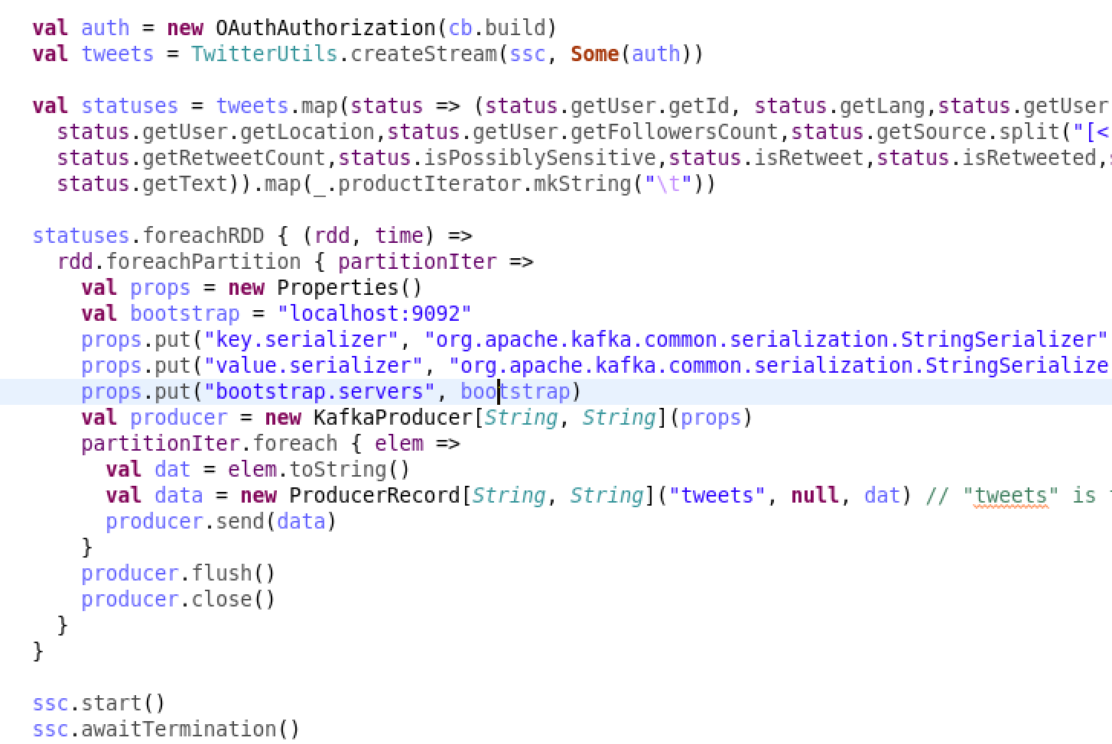
twitter producer Code and dependencies

Slide 14
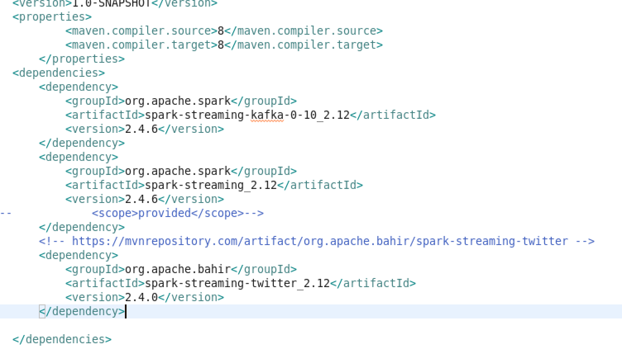
twit producer Code and dependencies

Slide 15
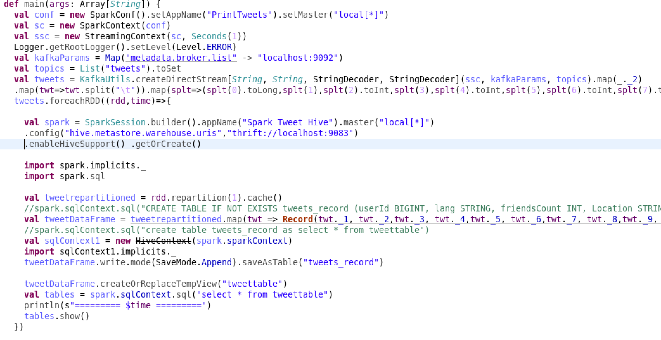
twit consumer Code and dependencies

Slide 16
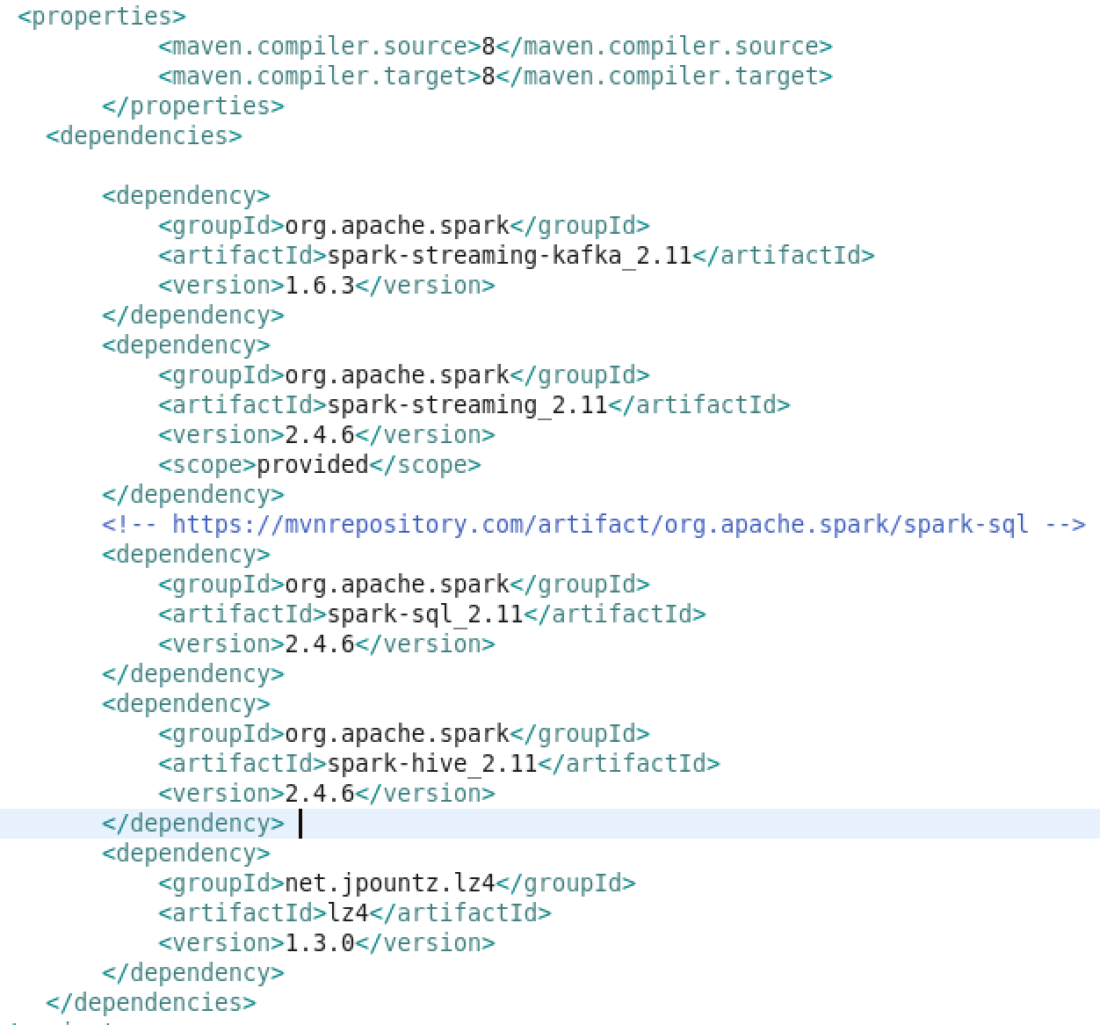
twit consumer Code and dependencies

Slide 17
Saving streamed data as parquet and hive table
Apache Parquet is a free and open-source column-oriented data storage format of the Apache Hadoop ecosystem. It provides efficient data compression and encoding schemes with enhanced performance to handle complex data in bulk.
Since it’s a column based format, it’s better to use when you only need to access specific fields
Each data file contains the values for a set of rows
Can’t be written from streaming data since it needs to wait for blocks to get finished. However, this will work using micro-batch (eg Apache Spark).
Suitable for data exploration — read intensive, complex or analytical querying, low latency data

Slide 18

Spark SQL
Spark SQL :
It is Spark module for structured data processing
It provides programming abstraction called Data frames.
It integrates relational data processing with the functional programming API of Spark.

Slide 19
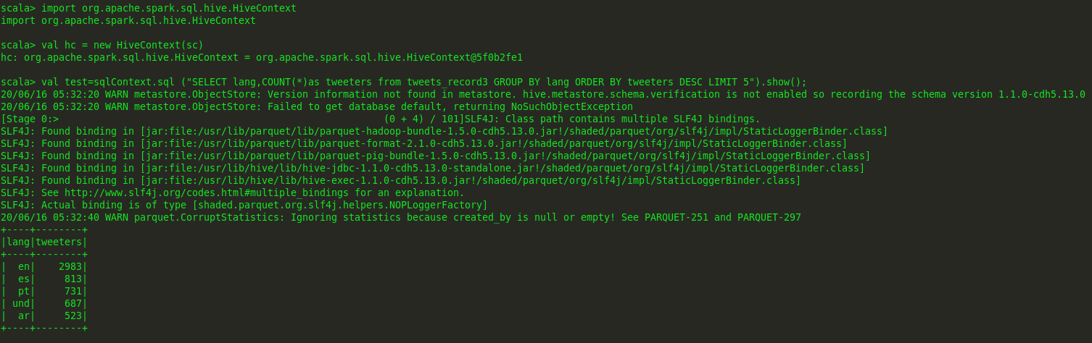
Spark SQL
We can run queries either from terminal using spark-shell or from Eclipse or other IDEs.
Query using spark-shell

Slide 20
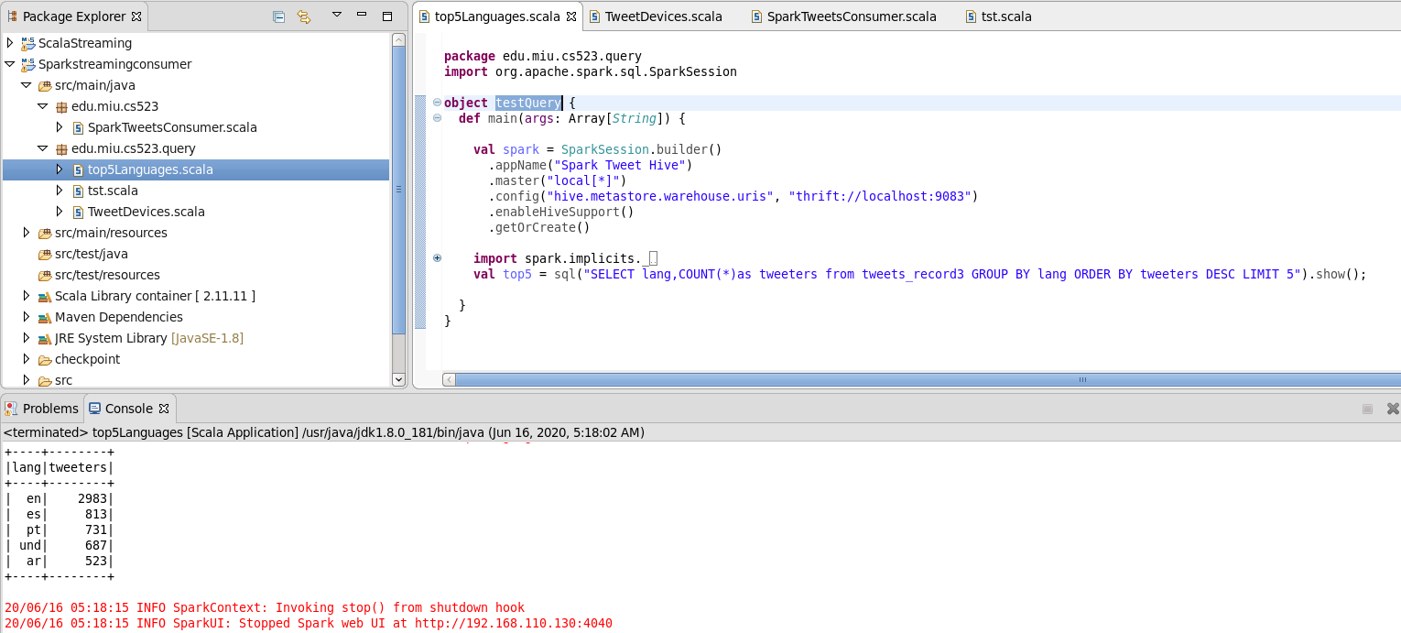
Spark SQL cont.…
Query using Eclipse IDE.

Slide 21
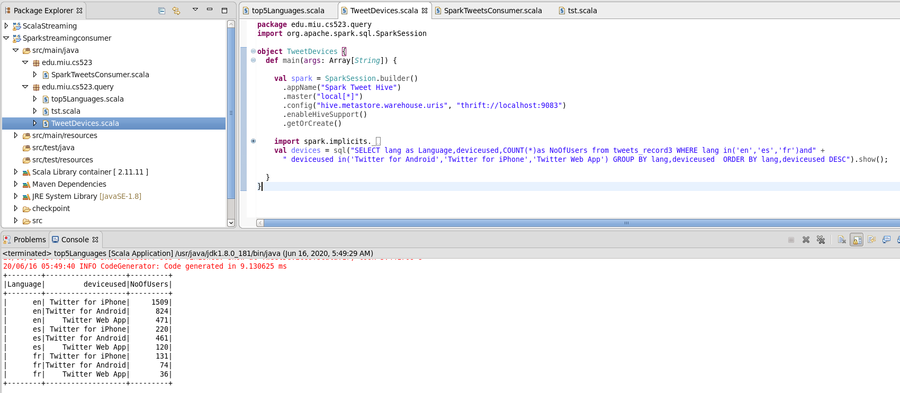
Spark SQL cont.…
We used Spark SQL to write and read data from Hive.
Query to Analyze common devices used by by Englis, Spanish and French speakers

Slide 22

Data Visualization

Slide 23
Outline
software used for the purpose
Environment setting
Sample Analysis visualization and demo
Machine learning approach for missed data?
Sample demo

Slide 24
Software and package used
Pyspark (version 2.4.6)
Miniconda3
Jupyter notebook
python
Pip
chart_studio
Numpy
Pandas
matplotlib

Slide 25


Why jupyter notebook
provide a way to play with data more.
Easy to integrate with machine learning
Hard code

Slide 26
Environment setting and communication
All modules
Jupyter notebook
miniconda
pip
Hive
Set Path and Home
Pyspark
Set Path and Home
Core-Spark
Soft link

Slide 27
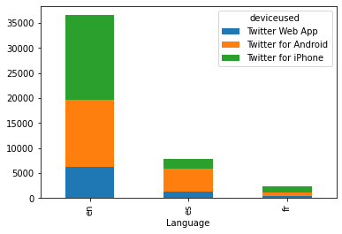
parkdf = hive_context. sql("SELECT lang as Language,deviceused,COUNT(*)as NoOfUsers from tweets_record3 WHERE lang in('en','es','fr')and" + " deviceused in('Twitter for Android','Twitter for iPhone','Twitter Web App') GROUP BY lang,deviceused ORDER BY lang,deviceused DESC")

Slide 28
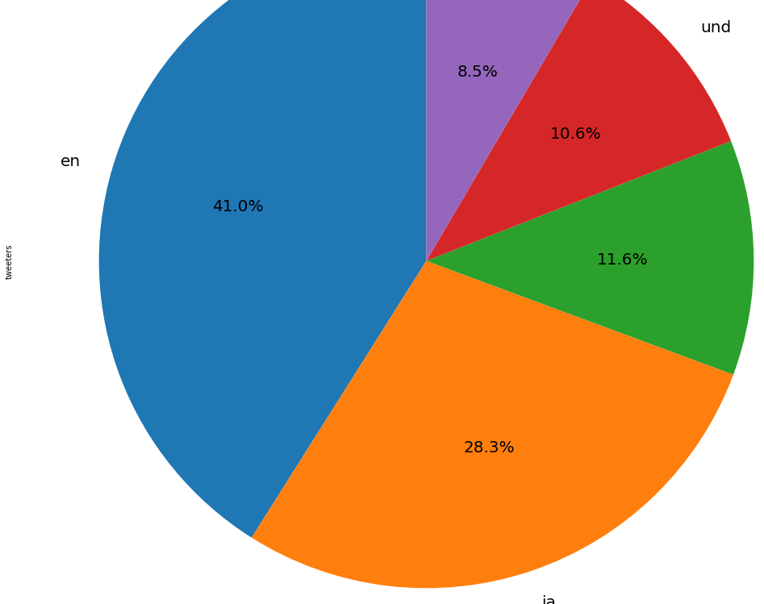
Top five language used in percent.

Slide 29
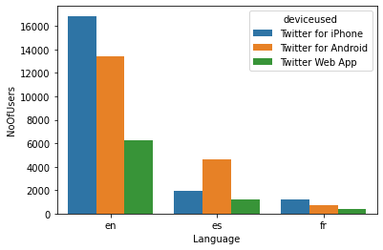
variety is the spice of life

Slide 30

.

Slide 31
Demos

